Slide 1

Implementation of Median Filter For Noise Removal in Images
1
BY
Sathwik. R USN:1CR21EC190
Tanuf Kashimji USN:1CR21EC225
Under the Guidance of Prof. Suganya Jeyaprakash
ELECTRONICS AND COMMUNICATION
Notes:
1

Slide 2
CONTENTS
2
Introduction
Methodology
Implementation
Result & Conclusion
Future Scope
References

Slide 3

INTRODUCTION
3
Noise can be produced by the image sensor and circuitry of a scanner or digital camera. Image noise can also originate in film grain and in the unavoidable shot noise of an ideal photon detector. Image noise is an undesirable by-product of image capture that obscures the desired information.
Salt and pepper noise is an impulse type of noise in images. We consider salt-and-pepper noise, for which a certain amount of the pixels in the image are either black or white (black or white dots). Normally if there is black dots in the image we called it pepper noise and if there is white dots in the image we called it salt noise. This noise is generally caused by errors in data transmission, failure in memory cell or analog-to-digital converter errors.
If we consider 8-bit image, salt and pepper noise randomly occur where they change certain amount of pixels into two extremes, either 0 or 255 (black & white respectively).
ECE

Slide 4
PSNR and SSIM
Peak signal-to-noise ratio (PSNR) is an engineering term for the ratio between the maximum possible power of a signal and the power of corrupting noise that affects the fidelity of its representation.
Typical values for the PSNR in lossy image and video compression are between 30 and 50 dB, provided the bit depth is 8 bits, where higher is better.
The Structural Similarity Index (SSIM) is a perceptual metric that quantifies image quality degradation caused by processing such as data compression or by losses in data transmission.
SSIM has been shown to be more accurate than PSNR in measuring image quality.
ECE

Slide 5
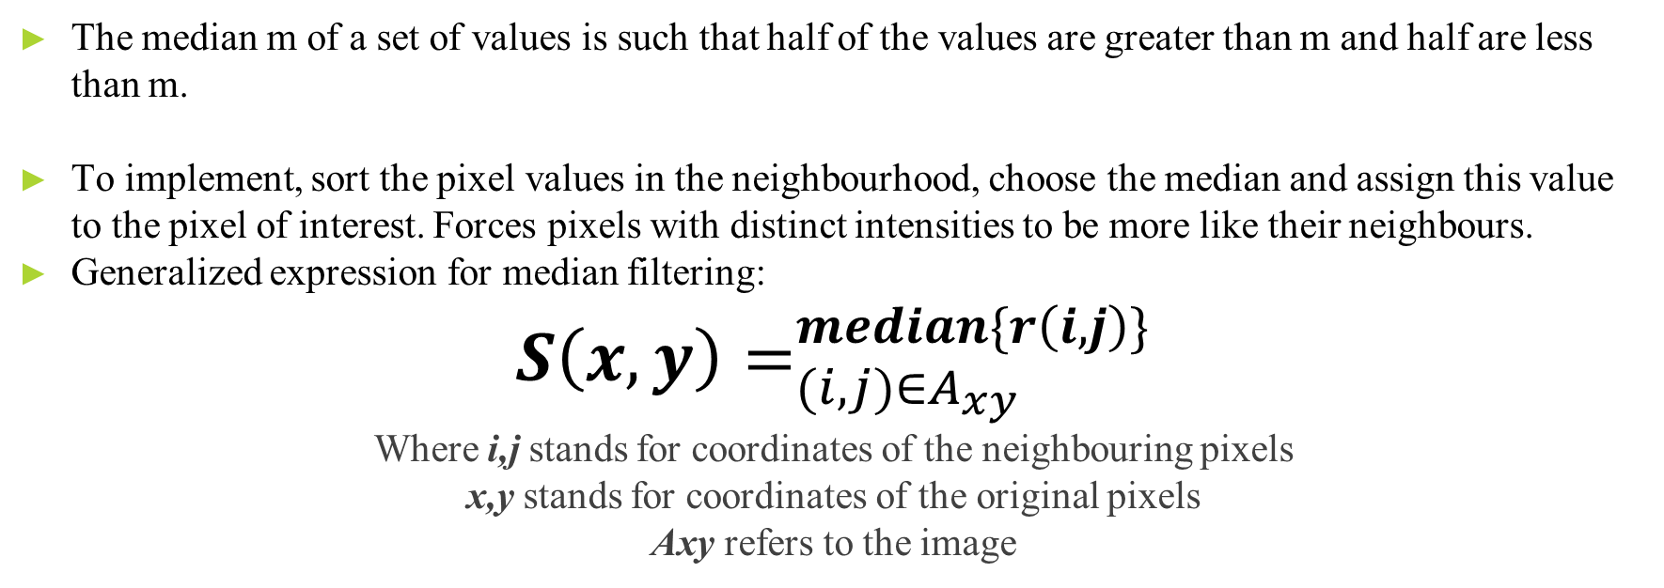
METHODOLOGY
5
The median m of a set of values is such that half of the values are greater than m and half are less than m.
To implement, sort the pixel values in the neighbourhood, choose the median and assign this value to the pixel of interest. Forces pixels with distinct intensities to be more like their neighbours.
Generalized expression for median filtering:
$${S\left(x,y\right)=}_{(i,j)∈A_{xy}}^{median\{r\left(i,j\right)\}}$$
Where i,j stands for coordinates of the neighbouring pixels
x,y stands for coordinates of the original pixels
Axy refers to the image
ECE

Slide 6
METHODOLOGY
Median filtering is excellent at reducing Salt and Pepper noise. The filtering algorithm will scan the entire image, using a small matrix, and recalculate the value by sorting the set of pixels and take the centre pixel values inside the matrix.
[12 23 34]
[22 16 67]
[45 56 78]
Considering the above matrix, the sorted values are: [12 16 22 23 34 45 56 67 78] Median of this set is 34.
ECE

Slide 7
IMPLEMENTATION
7
The filter is a set of pixels that is run through each pixel of the original image, replacing them with the result of the specific operation. The median filter of size n covers n x n pixels with the current pixel at its centre and replaces it with the median of the entire window. We use a n x n median filter that replaces each pixel with the median of its respective window and in turn, reduces the noise of the image. First, we make an array that is the same size as the original image array. We then loop through the pixels of the image and get the left, right, bottom, top, top left, top right, bottom left, and bottom right pixels in addition to the current pixel and store them in temporary variables. The median of these variables is then calculated and stored in the resultant array. The previous image after the application of a 3x3 median filter is displayed below, showing significant noise reduction.
ECE

Slide 8
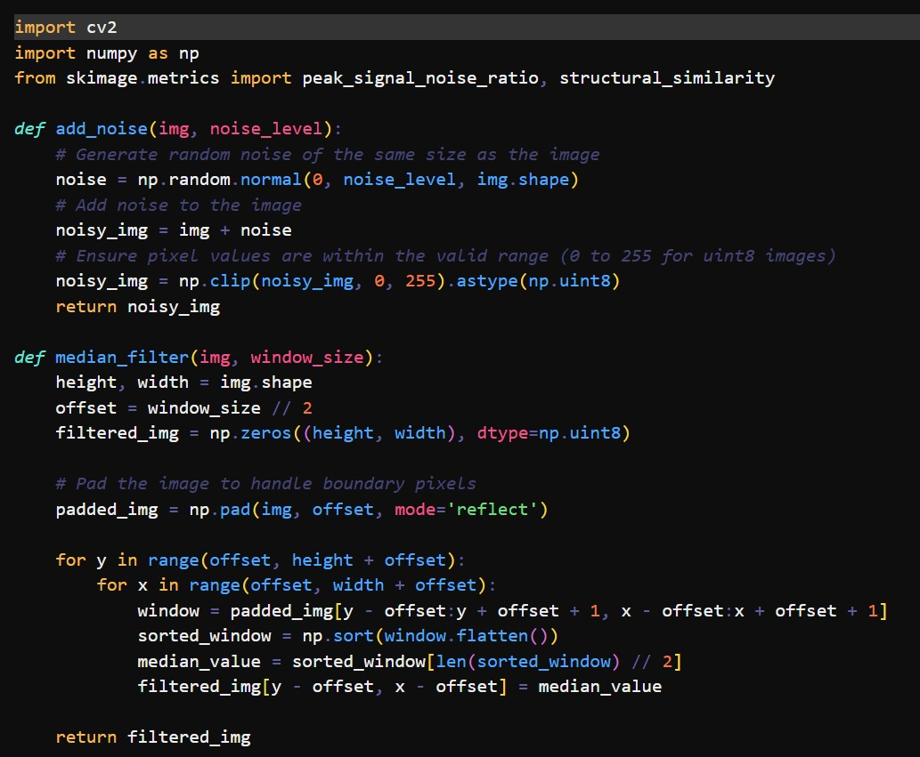
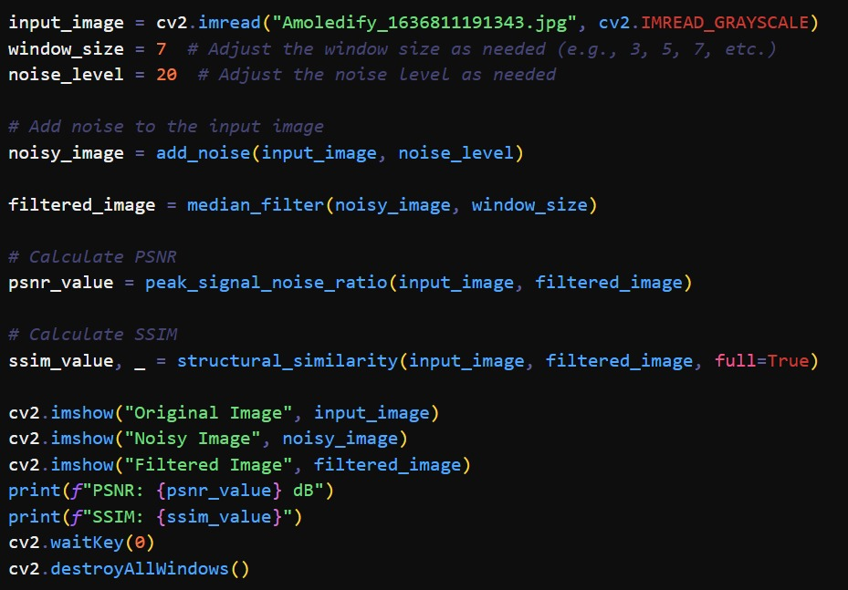
PROGRAM CODE :

Slide 9
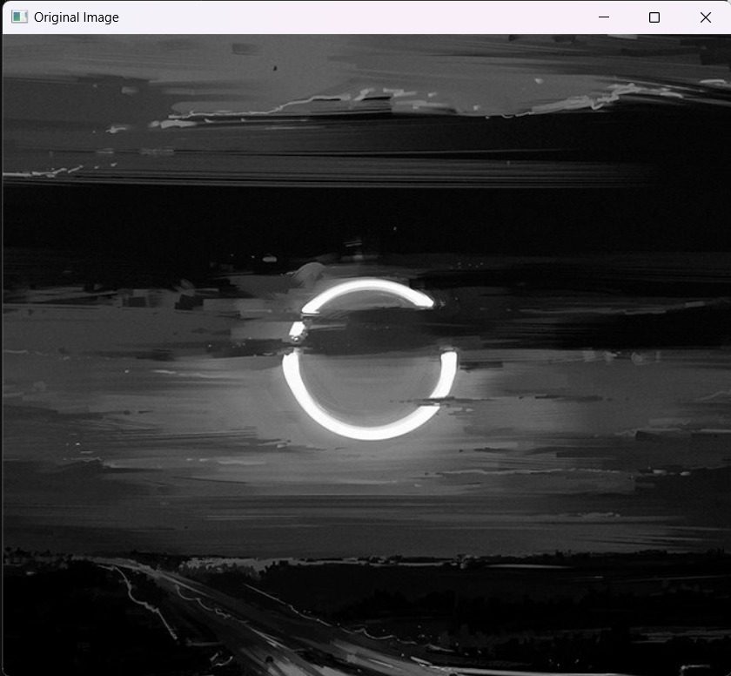
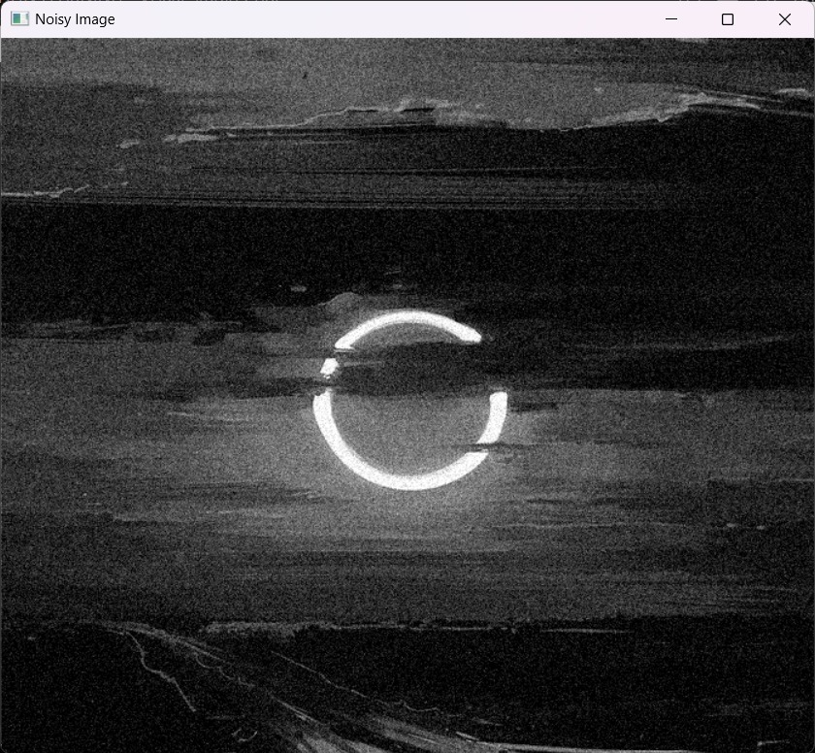
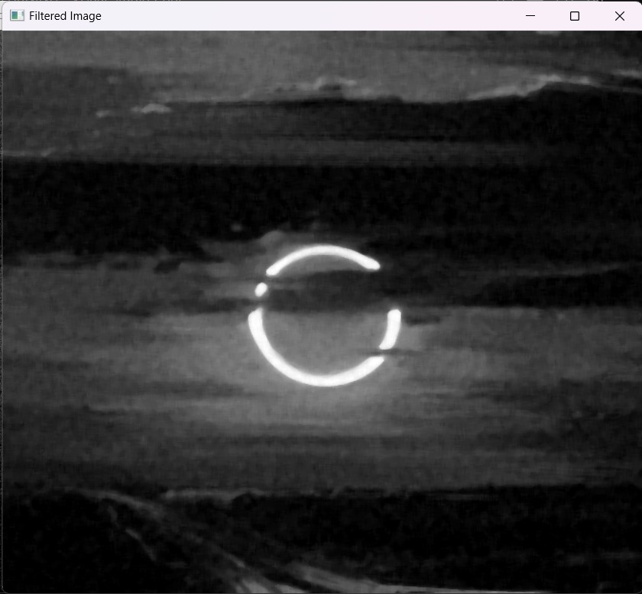
RESULTS
9

Slide 10
CONCLUSION
10
So in conclusion, Median filtering method can be used as an effective way of noise reduction.
Median filtering is widely used against salt and pepper noise because of its effectiveness against impulsive noise such as salt and pepper noise.
It can be further modified to reduce blurring.
ECE

Slide 11
FUTURE WORK
11
Median filtering can be used to improve the quality of images from traffic cameras. This can help to make it easier to identify vehicles and track their movements.
Median filtering can be used to improve the quality of images from security cameras. This can help to make it easier to identify people and objects.
Median filtering can be used to improve the quality of medical images, such as X-rays and MRI scans. This can help to make it easier to identify abnormalities and diagnose diseases.
Median filtering can be used to improve the quality of images from satellites and drones.
ECE

Slide 12
REFERENCES
12
https://medium.com/analytics-vidhya/remove-salt-and-pepper-noise-with-median-filtering-b739614fe9db
Digital Image Processing 4th Edition by. Rafael C. Gonzalez, Richard E. Woods.
ECE

